Slide 1
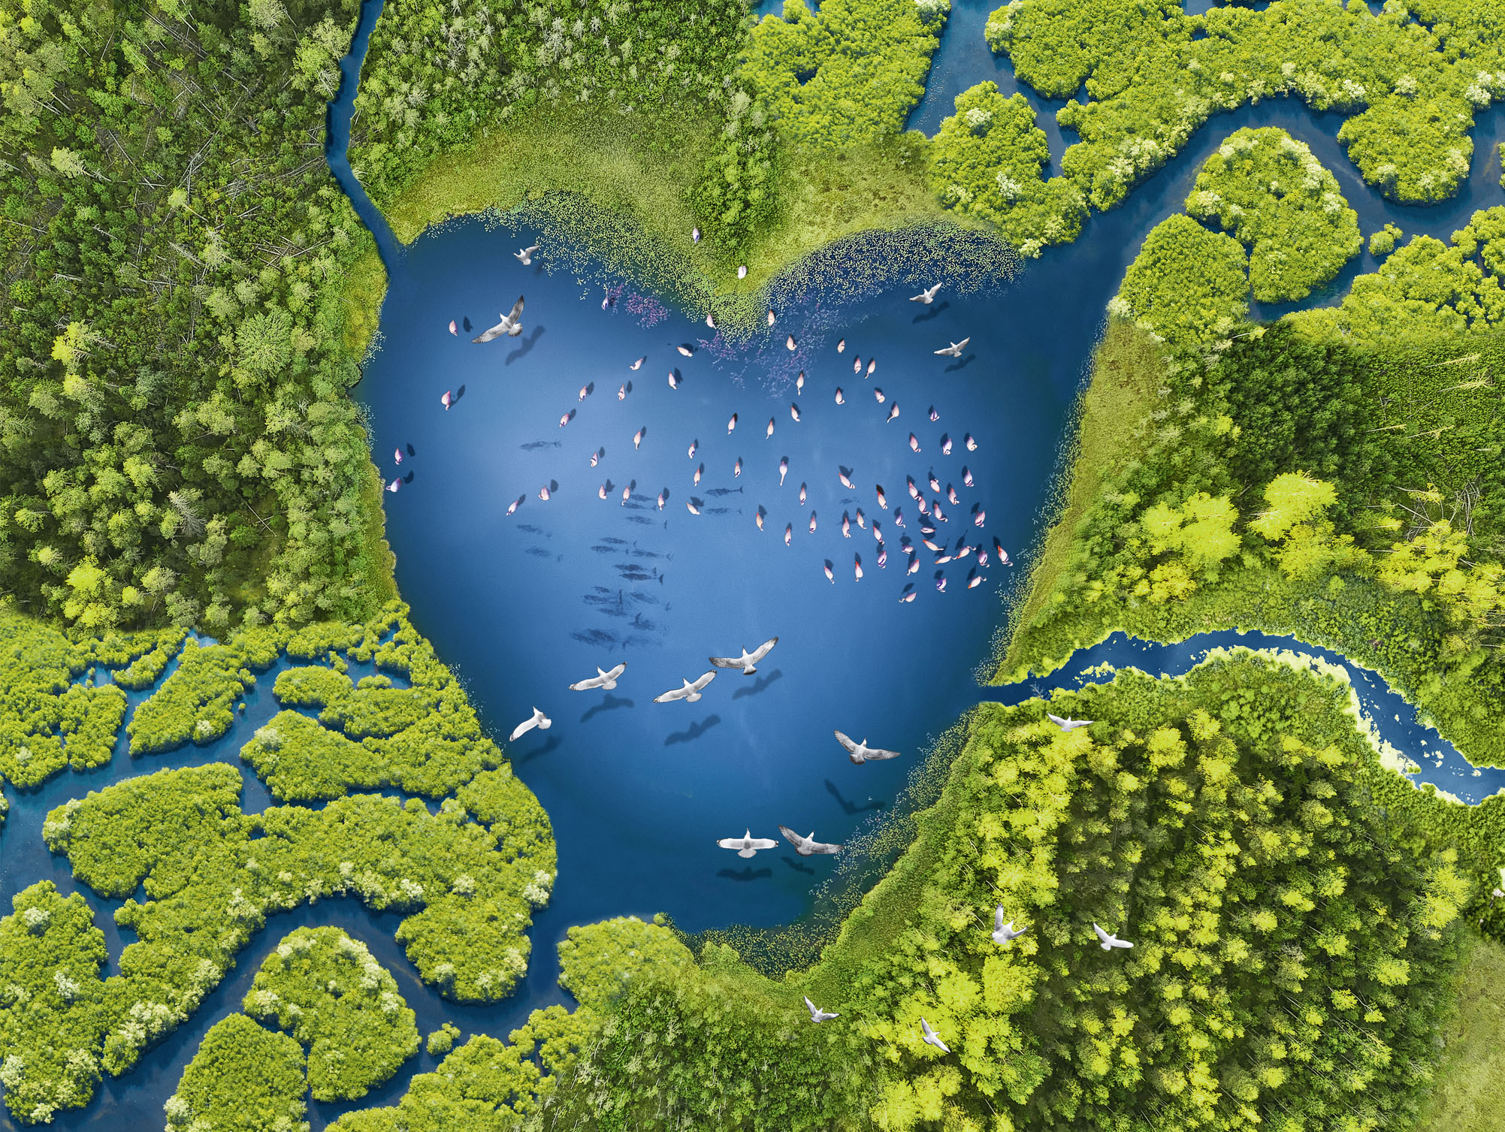
Inseparable
Water, Wetlands and Life

Slide 2
Wetlands - What are they?
Wetlands can be saltwater or freshwater, inland or coastal, natural or human made
Freshwater wetlands: rivers, lakes, pools, floodplains, peatlands, marshes, swamps
Saltwater wetlands: estuaries, mudflats, saltwater marshes, mangroves, lagoons, coral reefs, shellfish reefs
Human made wetlands: fishponds, rice paddies, reservoirs, saltpans

Slide 3
Wetlands and fresh water
Water, water everywhere… Our ‘blue’ planet seems awash with water
But only 2.5% of water is fresh water, mostly stored in glaciers, snow caps or underground aquifers
Less than 1% of fresh water is usable, 0.3% is in rivers and lakes
This is all the fresh water we have and wetlands provide most of it.

Slide 4
Inseparable: Water and wetlands
Wetlands are vital for water
Capture and store rainwater and replenish groundwater aquifers
Regulate water quantity and supply by releasing water at the right time to the right place in the right amounts
Improve water quality by removing and absorbing pollutants

Slide 5
Wetlands sustain life
Keep us healthy
Healthy watersheds provide safe drinking water naturally
Supply food, support food production
Wetlands give us much of the fish we eat, rice for 3.5 billion people and water for agriculture
Important for biodiversity
40% of world’s species live in wetlands, with 200 new fish species discovered in freshwater wetlands annually

Slide 6
Wetlands sustain development
Underpin economy
Wetlands provide more than a billion jobs and services valued at $47 trillion a year
Protect from natural disasters
Coastal wetlands buffer coastal communities against storms
Each acre of inland wetlands absorbs up to 1.5 million gallons of floodwater
Solutions for climate change
Peatlands, mangroves, saltmarshes, seagrass beds are among the most effective ecosystems for capturing and storing carbon

Slide 7
Water’s supply and demand
Unsustainable development, population growth, urbanization and consumption have devastated wetlands, putting unbearable pressure on freshwater supplies:
Water use has increased sixfold in the past 100 years, and is growing by 1% each year
We use more water than the earth can replenish
70% more food and 14% more water for agriculture needed for estimated 10 billion global population by 2050
Industry and energy water use expected to increase to 24% by 2050

Slide 8
Wetland loss and water scarcity
Loss and degradation of wetlands from changes to land and water use and climate change is intensifying a water crisis:
Nearly 90% of the world’s wetlands lost since 1700’s
Nearly all freshwater sources compromised by pollution and pathogens
River fragmentation and water flow interruptions by dams, diversions and wetland loss threaten freshwater supply
Nearly 75% of natural disasters water-related

Slide 9
Impact on people and economies
2.2 billion people without safe drinking water, 485,000 die each year
Freshwater wetland loss cost $2.7 trillion a year in lost services (1997-2011)
166,000 people killed and 3 billion affected by floods and droughts in past 20 years, causing nearly $700 billion of economic damage
Water insecurity a major role in conflict in at least 45 countries in 2017
Hundreds of millions of people in coastal areas face more threats from storms and floods due to mangrove, saltmarsh and seagrass loss

Slide 10
Wetland loss and our planet
One in three freshwater species and a quarter of all wetland species face extinction from wetland decline
Intensive water infrastructure development key to 35% drop in freshwater biodiversity between 1970-2005
Climate change exacerbates wetland and water crisis
Significantly less renewable surface and groundwater forecast in already dry regions by 2050
New regions will be water stressed, increasing water competition between people and ecosystems

Slide 11
Wetlands for water sustainability
We could have enough water, if we better value and manage wetlands and water – and treat both as a collective responsibilty.
Stop destroying, start restoring
Protection, restoration and wise use of wetlands would sustainably support increased demands for water
Integrated Water Resources Management
Coordinate water, land and resources to deliver maximum social and economic welfare fairly without compromising sustainability of ecosystems

Slide 12
Wetlands: Conserve and use wisely
What can you do ?
Don’t dam, divert or drain
Industry has opportunities to reduce water use by up to 50%
Agriculture can produce food and be wetland/water stewards
Don’t waste food. Water to fill Lake Geneva 3 times each year would be saved by cutting 1.3 billion tons of food waste from farm to fork
Increase investment in wetlands as nature based solutions for water resource management, currently less than 1%
Integrate water resource management across all sectoral policy and planning locally, national, internationally

Slide 13
World Wetlands Day 2 February 2021
2021 Theme: Wetlands and Water
Annual opportunity to raise global awareness on the value of wetlands
Celebrate wetlands’ diverse services to humanity and nature
Trigger action locally, nationally, internationally to save the world’s wetlands
Get involved:
Download and share information materials from worldwetlandsday.org
#RestoreWetlands
Where are your wetlands? How can you help protect them?

Slide 14
Sources
Types of wetland; aquaculture; Water pollution; climate change; biodiversity; wetland loss; sustainability – Global Wetland Outlook https://static1.squarespace.com/static/5b256c78e17ba335ea89fe1f/t/5ca36fb7419202af31e1de33/1554214861856/Ramsar+GWO_ENGLISH_WEB+2019UPDATE.pdf p22-24, p40, p43, p6, p61, p19
Wetlands take care of water https://www.ramsar.org/sites/default/files/documents/library/leaflet_1.pdf p4, p8
https://docs.wbcsd.org/2019/12/WBCSD_Feeding_3.5_billion-Innovative_finance_for_Climate-Smart_Rice.pdf
Ramsar news release, “World’s Most Valuable Ecosystem Disappearing Three Times Faster Than Forests, Warns New Report,” 27 September 2018, https://www.ramsar.org/news/wetlands-worlds-most-valuable-ecosystem-disappearing-three-times-faster-than-forests-warns-new
Ramsar Factsheet 6 Reservoirs of biodiversity https://www.ramsar.org/sites/default/files/documents/library/services_06_e.pdf p1
Worth of Wetlands: revised global monetary values of coastal and inland wetland systems https://www.publish.csiro.au/mf/MF18391
World Wetlands Day 2016 https://www.ramsar.org/sites/default/files/wwd16_hand-outs_desktop_print_eng.pdf
https://sciencing.com/do-wetlands-filter-water-6398284.html
UN WATER Water Development Report 2020: Water and Climate Change
https://www.unwater.org/world-water-development-report-2020-water-and-climate-change/ 21 March 2020
UNEP/IWMI Ecosystems for water and food security 2011 https://wedocs.unep.org/bitstream/handle/20.500.11822/8002/-Ecosystems%20for%20%20water%20and%20food%20security-20111057.pdf?sequence=3&amp%3BisAllowed= p2, 45, p65
UN WATER Water Development Report 2020: Water and Climate Change Facts and Figures
https://unesdoc.unesco.org/ark:/48223/pf0000372876.locale=en
https://www.unwater.org/water-facts/quality-and-wastewater-2/
https://www.who.int/news-room/fact-sheets/detail/drinking-water p6, p7, p10

Slide 15
Sources
Recent Loss of Freshwater Wetlands Worldwide Valued at $2.7 Trillion per Year
https://blog.nationalgeographic.org/2014/06/24/recent-loss-of-freshwater-wetlands-worldwide-valued-at-2-7-trillion-per-year/
The Geo Wetlands Initiative (GWOS)
https://www.ramsar.org/sites/default/files/documents/library/strp20_agenda_item_5_geo-wetlands_mpaganini.pdf
World Humanitarian Data and Trends 2018 https://www.humanitarianresponse.info/sites/www.humanitarianresponse.info/files/documents/files/whdt2018_web_final_singles.pdf p34
Global Biodiversity Outlook 5 https://www.cbd.int/gbo/gbo5/publication/gbo-5-en.pdf
p57, p68,p141
https://www.zsl.org/sites/default/files/LPR%202020%20Full%20report.pdf p24
IPCC Fresh water resources https://www.ipcc.ch/site/assets/uploads/2018/02/WGIIAR5-Chap3_FINAL.pdf p232
Half the world to face severe water stress by 2030 https://www.unenvironment.org/news-and-stories/press-release/half-world-face-severe-water-stress-2030-unless-water-use-decoupled 21 March 2016
Water Infrastructure and Investment High Panel on Water https://sustainabledevelopment.un.org/content/documents/hlpwater/08-WaterInfrastInvest.pdf
Food wastage: Key facts and figures http://www.fao.org/news/story/en/item/196402/icode/
Consumers discard a lot more food than widely believed https://journals.plos.org/plosone/article?id=10.1371/journal.pone.0228369, 12 February 2020
Is the world running out of fresh water? https://www.bbc.com/future/article/20170412-is-the-world-running-out-of-fresh-water

