Slide 1
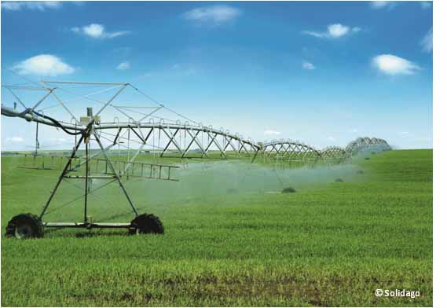
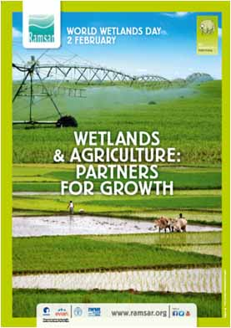
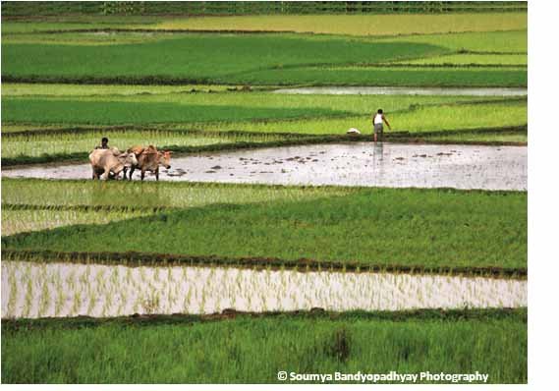
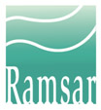
Wetlands and Agriculture: Partners for Growth?
World Wetlands Day 2014

Slide 2
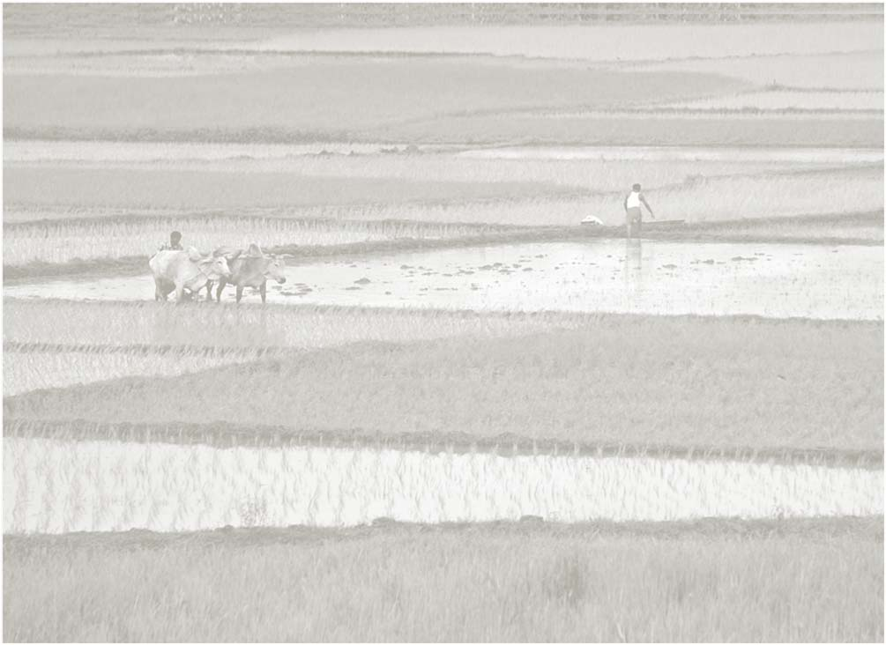
Wetlands & Agriculture: Partners for Growth? WWD 2014
Our World Wetlands Day (WWD) leaflet for 2014 looks at the relationship between agriculture and wetlands, at the role wetlands play in agriculture, at the negative impacts agriculture can have on wetlands, and at some of the creative solutions that are in use to reduce these impacts. It illustrates the need for real partnership between the two sectors (and with the water sector) to look at positive solutions and reduce the negative impacts.
Read the leaflet here in flashbook or download it in PDF www.ramsar.org/wwwd2014
This Powerpoint presentation is based on the leaflet. We hope that you will adapt and customize it to tell YOUR story about Wetlands and agriculture for your WWD event.

Slide 3
About the images in this PPT
Please note
The photographs in this PPT are copyrighted
They can be used in any adaptations of this PPT that you may prepare for a World Wetlands Day event
They may not be used for any other purpose without prior permission of the individual photographers. Contact the Secretariat on ramsar@ramsar.org for further information
Please do substitute other more relevant images for your own situation
Thank you for your cooperation

Slide 4
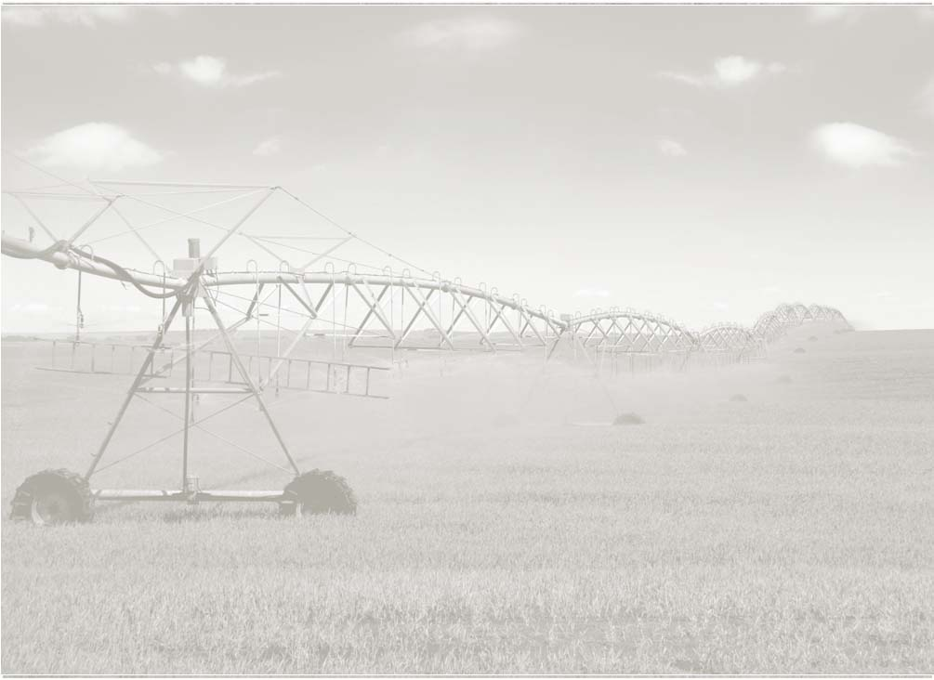
Contents
defining wetlands, Defining agriculture, and The scale of agriculture
Wetlands used for agriculture...complex interactions
Impact of agriculture & some Facts and Figures about water use
Agricultural vs Natural Ecosystem Services
Agriculture in Ramsar Sites

Slide 5
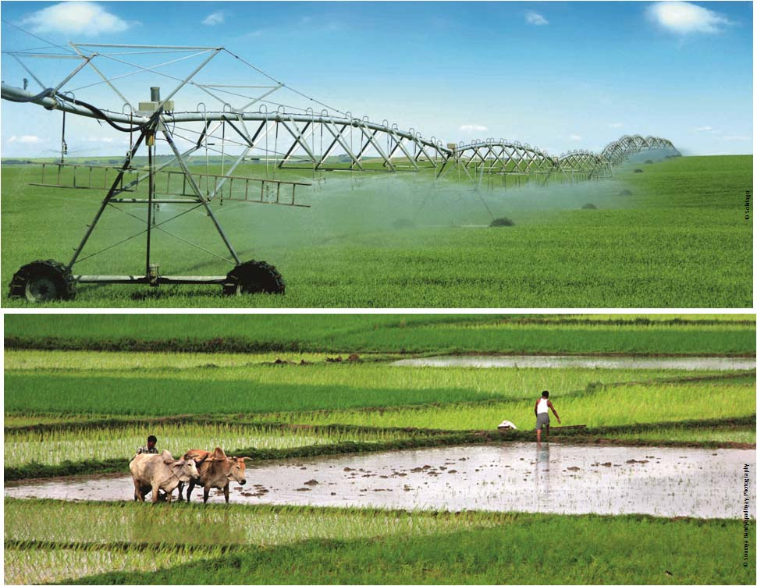
Defining Wetlands, Defining Agriculture,
& The Scale of Agriculture...

Slide 6
Defining agriculture .......
“the deliberate effort to modify a portion of Earth's surface through the cultivation of crops and the raising of livestock for sustenance or economic gain”.
Crops can provide food, fuel, medicines. For our purposes, this definition of agriculture includes land-based agriculture, inland and coastal aquaculture. Aquaculture as defined by FAO includes the farming of animals (e.g. crustaceans, finfish and molluscs) and plants (e.g. seaweeds and freshwater macrophytes).

Slide 7
Defining wetlands .......
Ramsar uses a broad definition of wetlands, including lakes and rivers, swamps and marshes, wet grasslands and peatlands, oases, estuaries, deltas and tidal flats, near-shore marine areas, mangroves and coral reefs, and human-made sites such as fish ponds, rice paddies, reservoirs, and salt pans.

Slide 8
Scales and types of agriculture
Intensive agriculture
Uses more fertilizers, chemicals, modern machinery or manual labour; generates higher levels of productivity from relatively smaller areas
Extensive agriculture
Uses smaller inputs relative to land area – relies more on natural processes and productivity
Crop production can be
Rainfed
or
Irrigated
Irrigation through spraying or mist-jet, and drip irrigation systems
Combined production systems
Bring together crop farming, animal husbandry, sometimes aquaculture in one farming system. Can be intensive or extensive.

Slide 9
Wetlands used for agriculture...
complex interactions

Slide 10
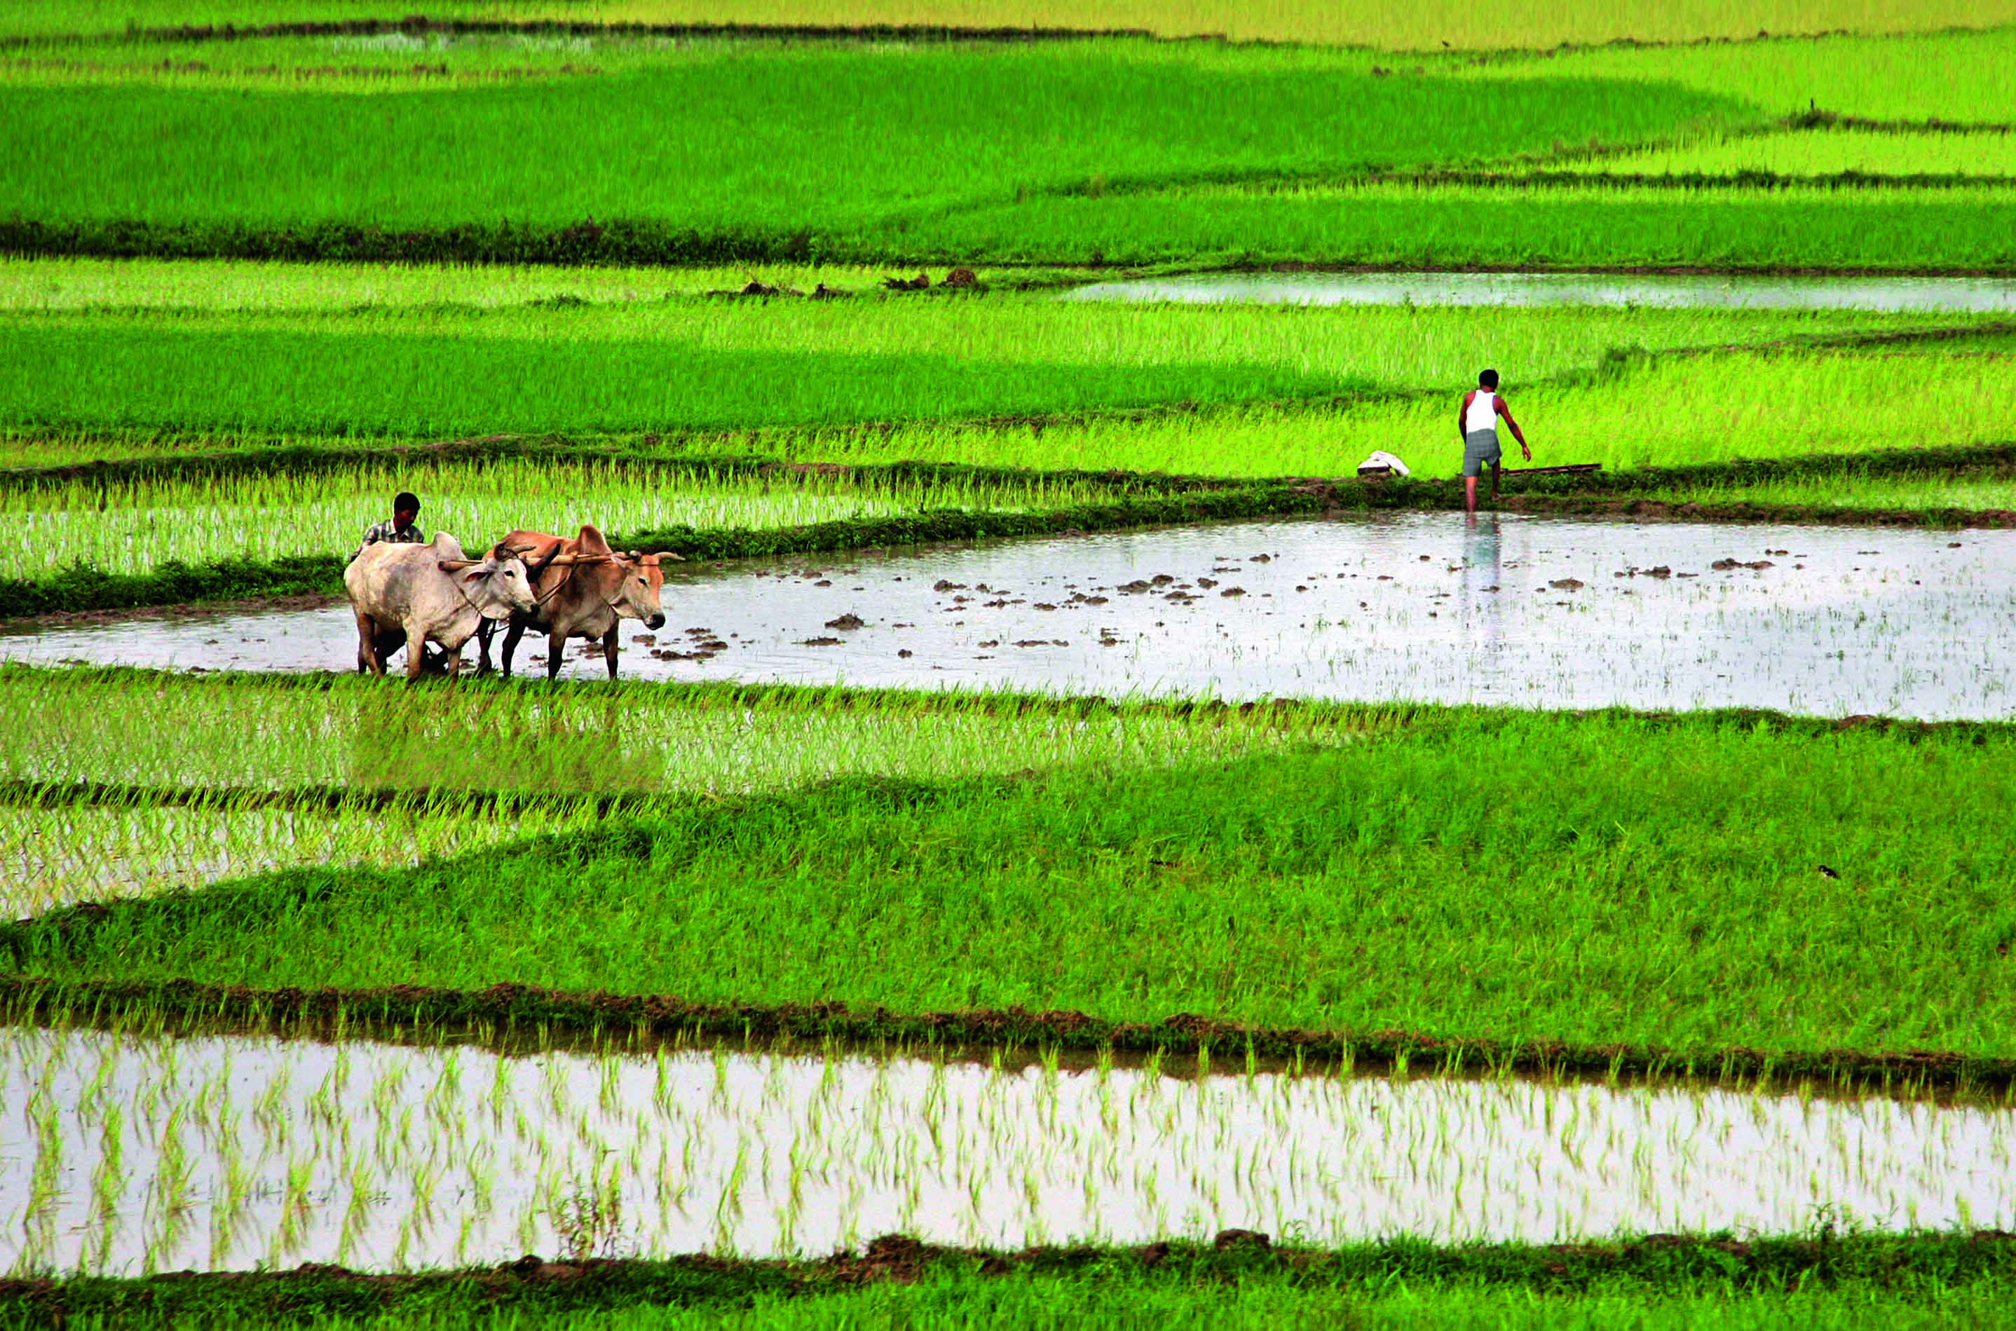
Complex interactions ...... Wetlands used for agriculture may be:
Wetlands dependent on continued agricultural activities to maintain ecological character - such as mowing and grazing in wet grasslands.
Wetlands that have been converted to support agriculture, e.g., flood recession agriculture in floodplains; rice paddies, coastal grazing marshes.
Wetlands maintained in a natural state for production and harvesting of specific products, e.g., wild rice beds in a wetland that are managed and harvested using traditional techniques.
Wetland systems constructed or managed expressly for agriculture may also have significant wetland biodiversity values e.g., cranberry bogs, fish ponds, or reservoirs originally built for irrigation which also support migratory waterbirds and other wetland species.

Slide 11
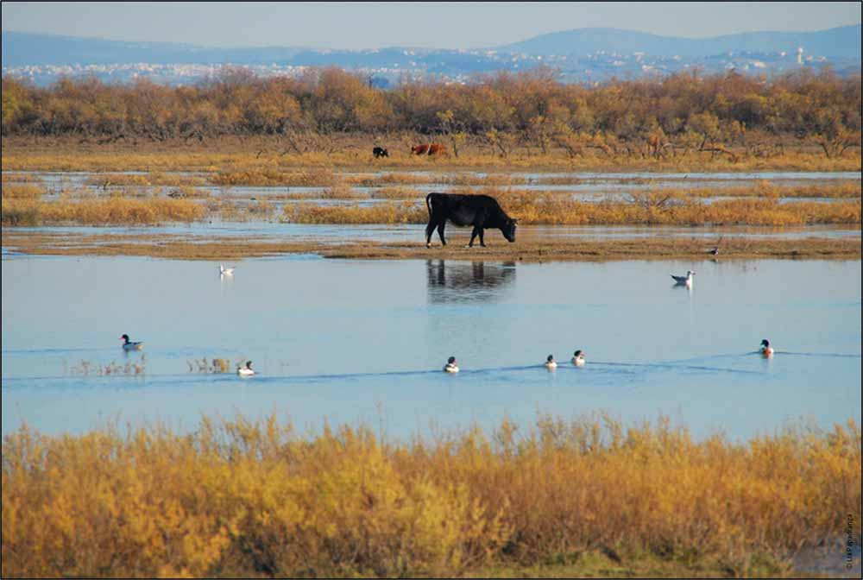
A coastal grazing marsh in the Axios Delta, Greece. Grazing helps maintain the marsh ecosystem.

Slide 12
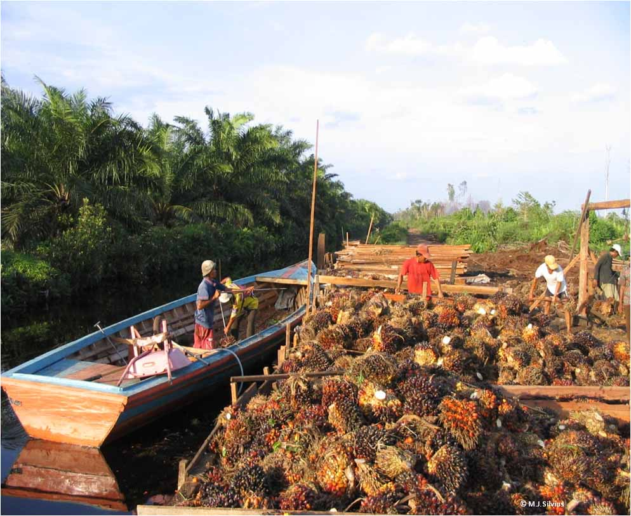
Wetlands and biofuels 1 – Friends? Foes?
Cultivation of crops for bioenergy has increased rapidly since 2000; land requirements by 2030 are expected to be about 35 million hectares. Land and water impacts on wetlands from biofuel production can be significant...
Tropical peatlands in southeast Asia have been drained for production of palm oil for bioenergy (approx 880,000 ha
by early 2000s)
Sugar cane in many parts of Africa is planted in or near wetlands , some for biofuel production – this causes wetland loss, heavy water use, and affects soil fertility
M.J. Silvius

Slide 13
Wetlands and biofuels 2 – Friends? Foes?
Cultivation of crops for bioenergy has increased rapidly since 2000; land requirements by 2030 are expected to be about 35 million hectares. Land and water impacts on wetlands from biofuel production can be significant...
In the Neotropics oil palm plantations adjacent to wetlands have caused the loss of natural vegetation and water pollution.

Slide 14
Key message 1
Wetlands serve as valuable natural infrastructure for agriculture, providing reliable water and fertile soils, but they are at risk from agriculture’s growing demands for land and water. They are increasingly threatened by population growth, large-scale development initiatives intended to alleviate poverty, and the possible impacts of climate change. The functions and economic values of wetlands must be considered in planning for the production of food and other agricultural products.

Slide 15
Impact of agriculture;
Water Facts and Figures

Slide 16
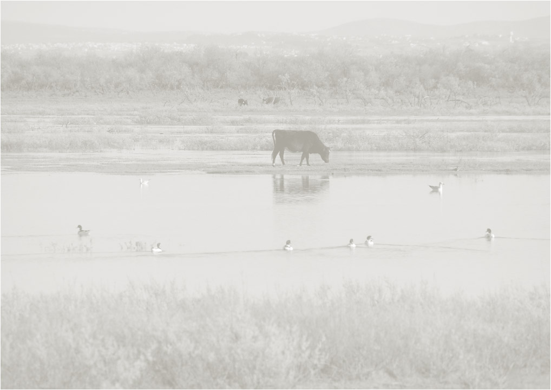
Impacts of agriculture on wetlands - in brief
Water quantity impacts that damage/alter wetlands:
Decreases in flows due to dams and water abstraction (surface and groundwater) for irrigation or other purposes
Increases in river flows or water levels due to irrigation return flows or dam releases
Changes in the timing/patterns of river flows
Water quality impacts:
Intensive agriculture activities including intensive aquaculture often lead to increased loads of pollutants such as pesticides, fertilizers, antibiotics and disinfectants affecting wetland and human health & drinking water quality
Wetland conversion and disturbance impacts through agriculture:
Introduction of invasive species
Introduction of human and animal disease vectors
Disturbance of breeding, migration, feeding patterns of wetland fauna

Slide 17
Facts and Figures
Percentage of all withdrawals from surface water and groundwater used for agricultural purposes. Most is used for irrigation: some finds its way back to rivers and groundwater as return flows, the rest returns to the atmosphere through evapotranspiration.
The approximate percentage of irrigated areas that rely on groundwater either as a primary source or in conjunction with other sources of water.
Estimated percentage of current agricultural water needs met by irrigation – the rest is provided by rainfall. Balance between rainfed and irrigated agriculture is highly variable around the world (see Fig 2)

Slide 18
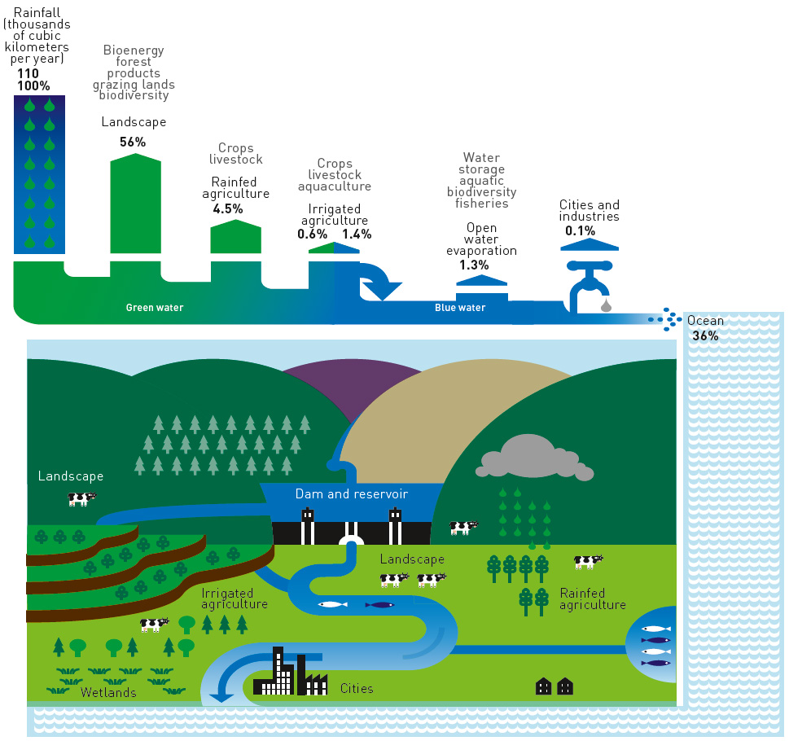
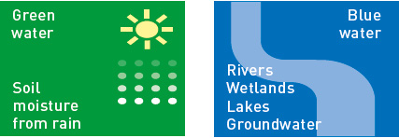
Water use in rainfed and irrigated agriculture
Rainfed agriculture relies largely upon green water.
Irrigated agriculture relies mostly on wetlands - blue water.
20% of our current agricultural water needs are met by irrigation; 80% from rainfall.
Source: www.iwmi.cgiar.org/Assessment/
Fig. 1

Slide 19
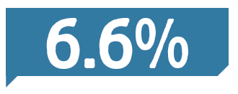
Facts and Figures
Estimated increase by 2050 of current agricultural water consumption mostly for irrigated agriculture in already water scarce areas.
% of World’s land surface used for crop production. Crop area is not increasing fast but intensification is.
Irrigated areas have doubled in the last 50 years.
Average growth per year in food fish production from aquaculture from 1970 to 2008 – brings more pressure on inland and coastal wetlands.

Slide 20
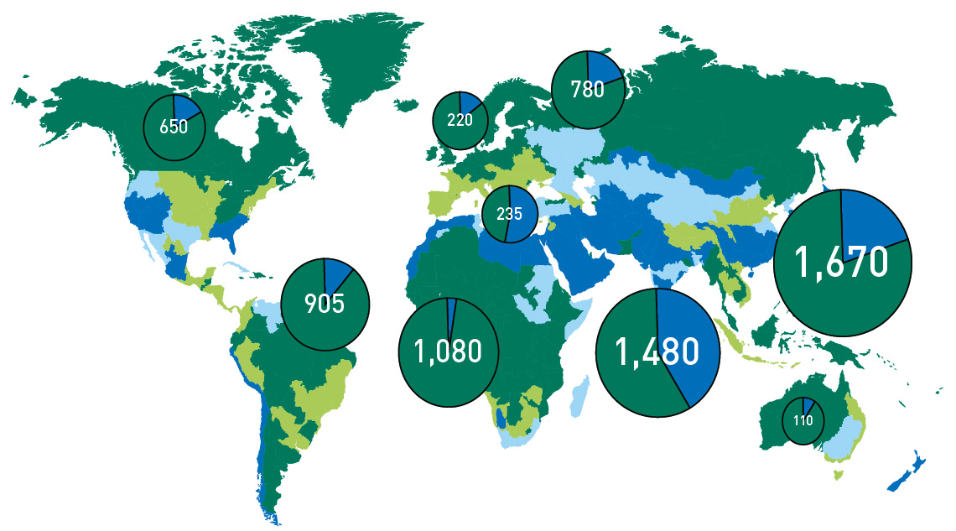
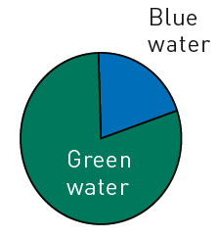
Balance between rainfed and irrigated agriculture is highly variable around the world
Source: www.iwmi.cgiar.org/Assessment/
Pie charts show total crop water evapotranspiration in km³ by region.
The map shows those areas heavily dependent on irrigated water for agriculture. Estimated that 20% of agricultural water comes blue water (= wetlands & groundwater); 80% from green water.
Fig. 2

Slide 21
Key message 2
In many parts of the world water resources have already been utilized at or beyond their sustainable limits. Agriculture will need more water to support more people in future, yet wetlands must still have enough water to maintain their ecological character and essential ecosystem services.
Key message 3
Agriculture will need more land to support more people in the future, but conversion of wetlands for agriculture will lead to the loss of vital wetland ecosystem services.

Slide 22
Agricultural vs Natural Ecosystem Services

Slide 23
Provisioning services: production of food, fuelwood, fish, water storage etc. Regulating services : climate regulation, water purification etc. Cultural services : recreation, spiritual value, educational value etc.
Nature’s Capital
Wetland Ecosystem Services
Value of Wetland Ecosystem Services:
www.ramsar.org/TEEB-report

Slide 24
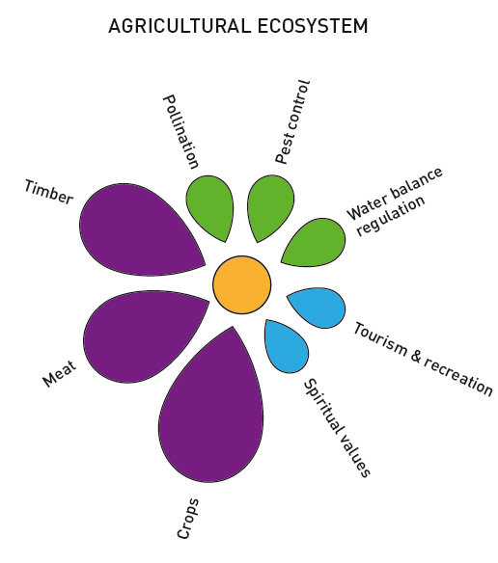
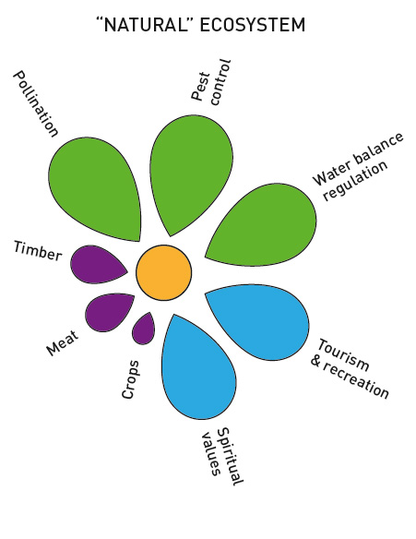
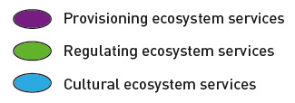
Agricultural vs Natural Ecosystem Services
From: Agricultural Water Management 97(4): 512-519
Agriculture tends to result in more emphasis on provisioning services. This often results in the reduction of naturally occurring regulating services – such as pollination, water balance regulation, and pest control .

Slide 25
© Solidago
Reducing Agricultural Impacts
© Soumya Bandyopadhyay Photography

Slide 26
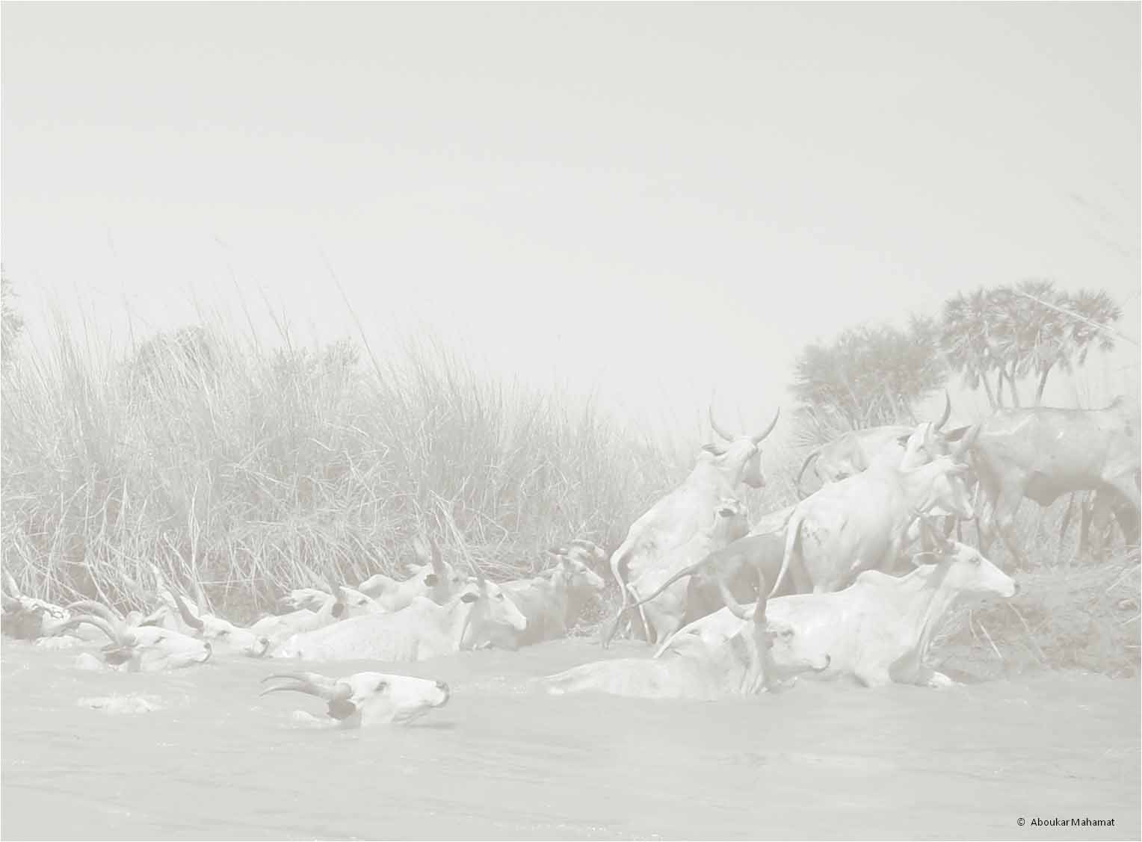
REDUCING THE IMPACTS OF AGRICULTURE ON WETLANDS
More crop per drop
Integrated water resources planning
Reducing the impacts of agriculture on water quality
More crop per drop
e.g. through
improved efficiency in irrigation technologies
use of drought-tolerant crop varieties to reduce irrigation needs
cultivation of more flood-tolerant crops
use of smart phone technologies to give farmers access to
weather and crop data in the field
water re-use and wastewater use in agriculture to reduce water withdrawals
return flows from urban areas to reduce withdrawals (and wetlands can help provide treatment)

Slide 27
Integrated water resources planning e.g.
large dams may reduce vulnerability of farmers to drought
small local storage options – such as tanks and farm dams - can provide local resilience and sustain wetland biodiversity
large dams can be designed and operated for multiple uses such as agriculture, hydropower, fisheries and recreation, and should allow water releases for downstream ecosystems
Reducing the impacts of agriculture on water quality
e.g.
Using options such as conservation tillage and organic farming can reduce pollution loads reaching wetlands
Integrated pest management can reduce pesticide needs
Combined production systems can utilize livestock manure to fertilize crops and aquaculture (and reduce costs at the same time)

Slide 28
Agriculture in Ramsar Sites

Slide 29
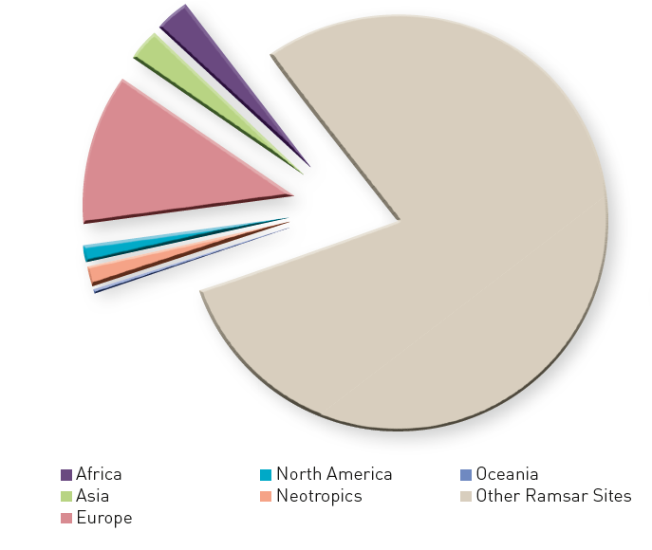
Agriculture IN Ramsar Sites – Did you know?
20% of Ramsar Sites (August 2013) include one or more of these Ramsar wetland types:
Aquaculture
Ponds, i.e., farm or stock ponds, small tanks
Irrigated land including irrigation channels, rice fields
Seasonally flooded irrigation land

Slide 30
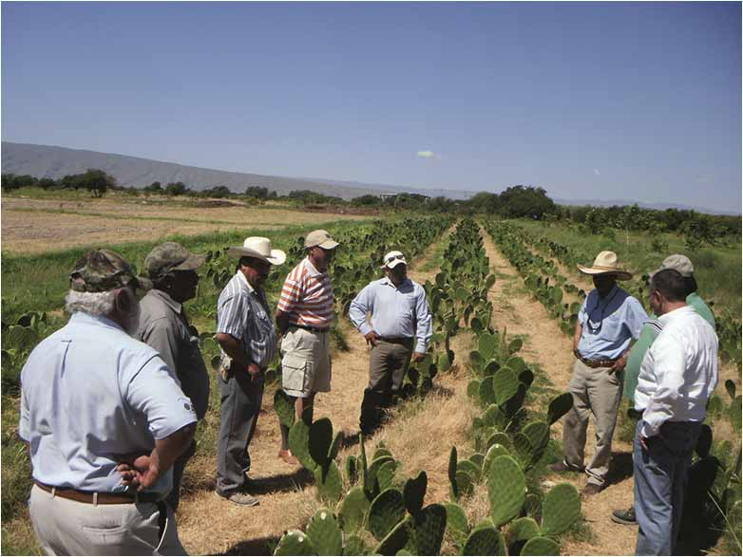
A complex of streams, marshes and lakes where a local conservation network has joined efforts with the users of water from the wetland for agriculture. New crops have been introduced such as the prickly pear from which the vegetable nopal is prepared. This cactus has replaced traditional crops with higher water requirements, generating higher income for farmers and reducing the water needs from the wetland.
Mexico: Cuatro Ciénegas Wildilfe Protection Area Ramsar Site
A© PFF Cuatrociénagas

Slide 31
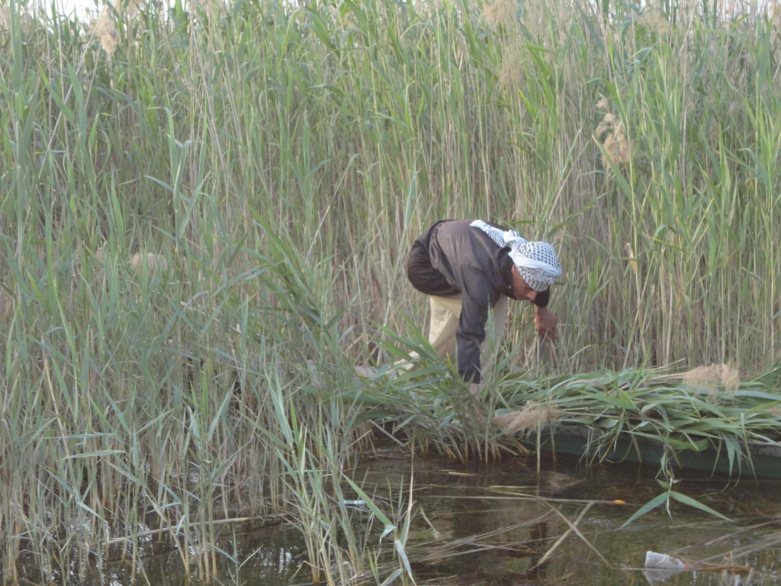
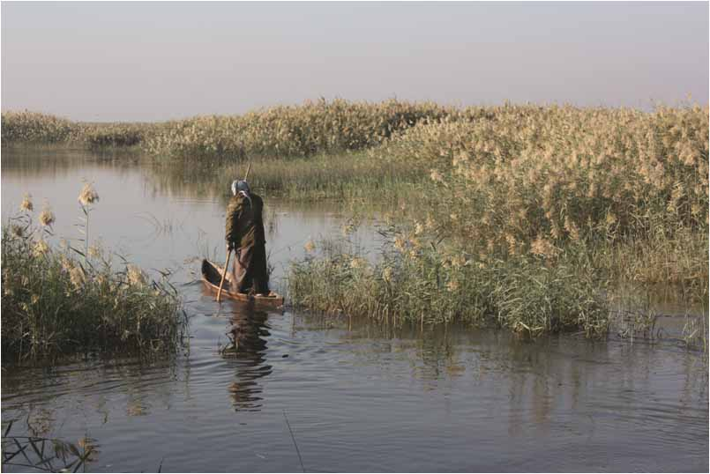
Iraq: Hawizeh Marsh (Haur Al-Hawizeh) Ramsar Site The indigenous tribes of Marsh Arabs, or Madans, have practiced their traditional agriculture in the Mesopotamian Marshlands for over 5,000 years, gathering reeds, cultivating cereals and date palm, grazing large livestock, fishing and hunting.
Jassim Al-Asadi
Jassim Al-Asadi
Jassim Al-Asadi

Slide 32
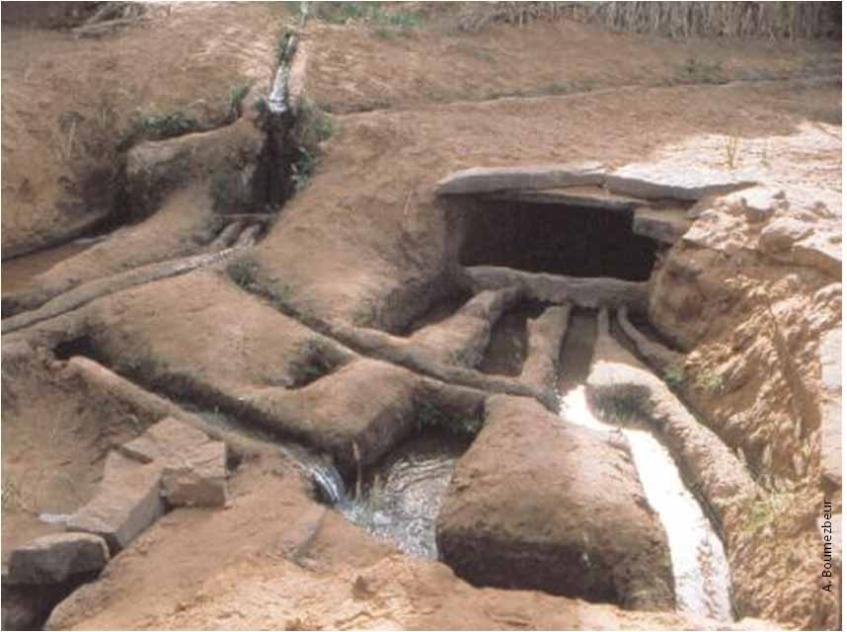
Algeria: Oasis de Ouled Saïd Ramsar Site
This human-made Ramsar Site was created on the remains of a “fossil” wadi where a traditional “fouggara” system has been constructed for the capture and distribution of groundwater. The water, distributed in small open-air channels is shared out equitably to individual gardens for the cultivation of palms, cereals and fruits. The site is also important for migratory birds and includes important archaeological remains of “Ksars” (fortresses) from the 14th century.

Slide 33
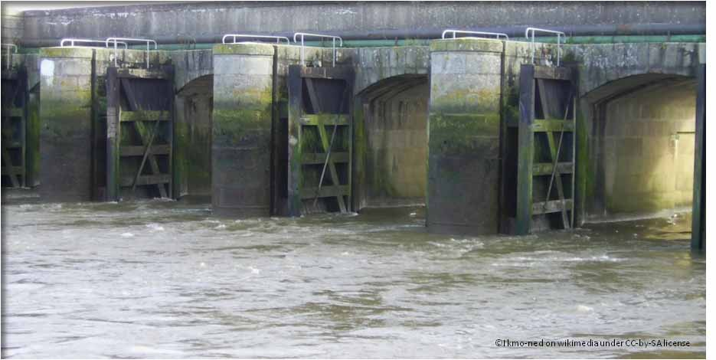
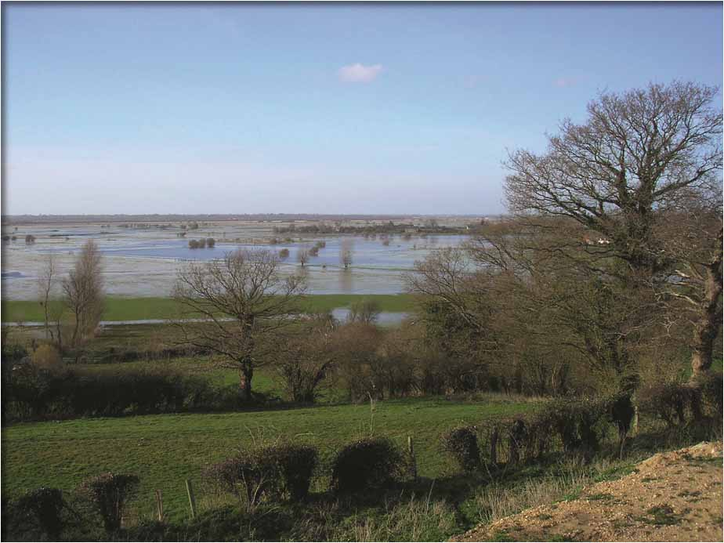
France: Cotentin & Bessin Marshes Ramsar Site
The marshes of the Cotentin and Bessin in France are flooded in winter and provide a huge area for fish and waterbirds. When they dry in spring, local farmers release their cattle on the rich pasture land. The surrounding higher meadows are used for hay making. This sustainable way of dairy farming evolved in Medieval times and still suits modern agricultural needs.
Ikmo-ned on wikimedia under CC-by-SA license
© Ikmo-ned on wikimedia under CC-by-SA license

Slide 34
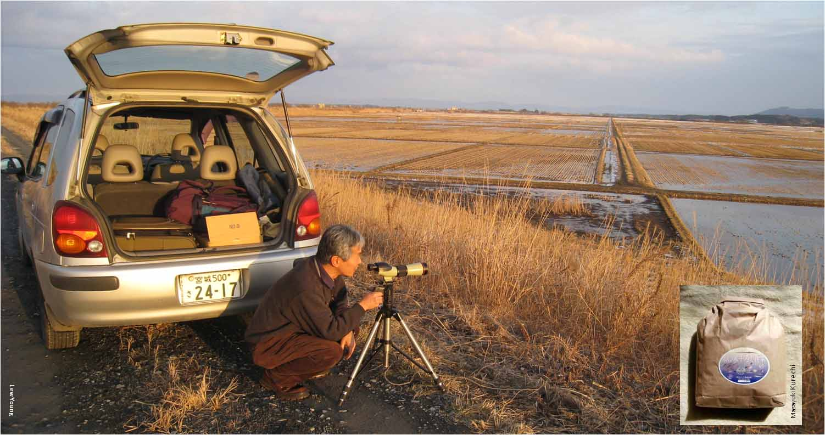
Japan: Kabukuri-numa Ramsar Site
These rice paddies are farmed organically AND are managed to attract wintering waterbirds. In winter and post-harvest, the rice fields are left flooded for wild birds to winter in the site; later the nutrient-rich soil from droppings is used as natural fertilizer for the wild rice, in addition to controlling weeds and pests. Good for farmers, birds and birdwatchers!

Slide 35
Key message 4
Improving the agricultural productivity of land and water can help to limit the amount of water that is withdrawn from wetlands and discourage their conversion for agriculture.
Key Message 5
Intensification of agricultural activities can provide some efficiency gains, and so too can adoption of new technologies by farmers or the reintroduction of traditional practices with new technological support.
Key Message 6
Managing land and water to create multifunctional agroecosystems helps to provide diversity and resilience for livelihoods and maintain a balance between provisioning, regulating, supporting, and cultural wetland ecosystem services.

Slide 36
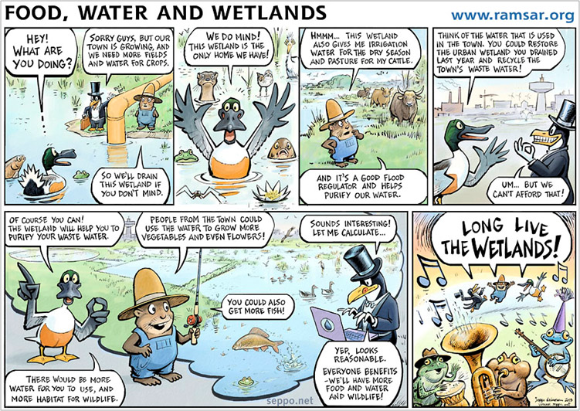
And finally ... Please use our cartoon as a teaching aid to tell a story.
Or use the blank cartoon to create your own story www.ramsar.org/wwd2014

Slide 37
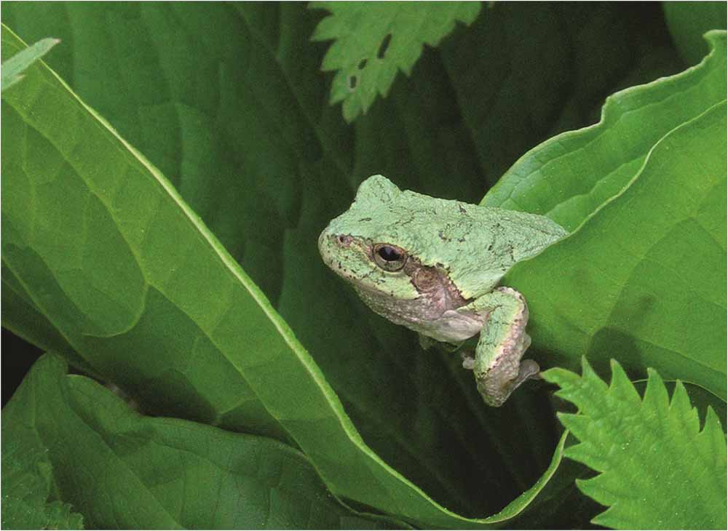
www.ramsar.org
© Gary Shackelford
Ramsar’s WWD materials are generously supported by the Danone Fund for Water
The leaflet was produced in collaboration with the UN Food and Agriculture Organization and the International Water Management Institute

