Slide 1
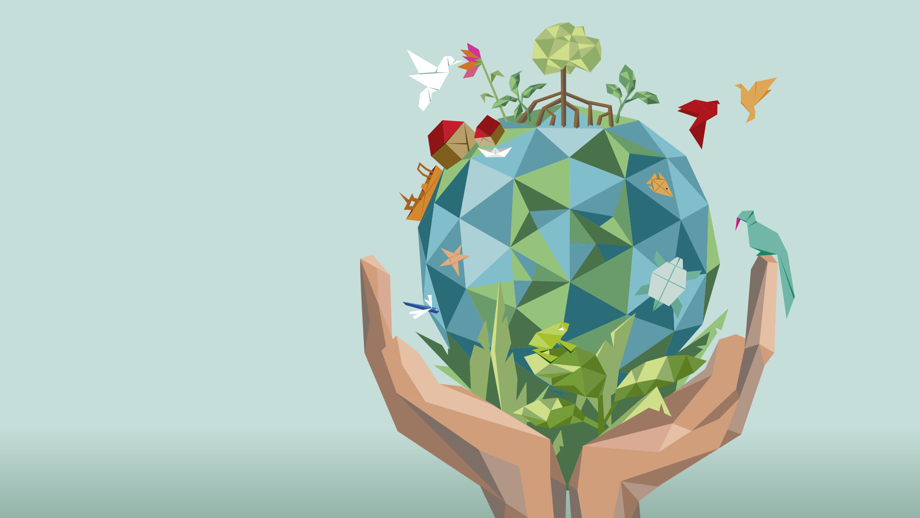
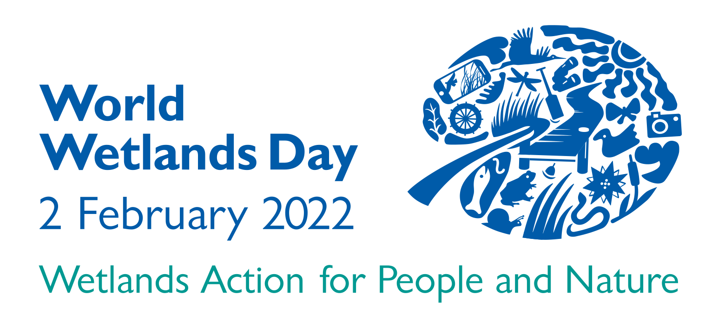
WETLANDS
VALUE – MANAGE – RESTORE – LOVE
www.worldwetlandsday.org
#ActForWetlands
#WorldWetlandsDay

Slide 2
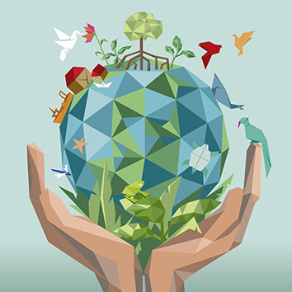
World Wetlands Day
An annual opportunity to unite for wetlands
Far-reaching event that heightens awareness of critical importance of wetlands to people and the planet
Celebrated every 2 February since 1997 by Parties to the Convention on Wetlands and others
Marks anniversary of the Convention on Wetlands — adopted in 1971 as an international treaty
First of the modern global multilateral environmental agreements
Only one devoted to a specific ecosystem – wetlands
For first time ever, will be officially observed within context of United Nations ― UN General Assembly adopted it as an international day
2022 Theme — Wetlands Action for People and Nature
An urgent call for greater investments of financial, human and political capital to conserve wetlands and ensure they’re used wisely and sustainably
#ActForWetlands #WorldWetlandsDay WorldWetlandsDay.org

Slide 3
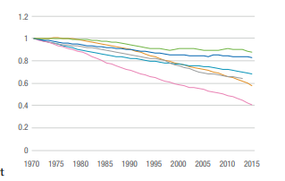
Natural wetlands are declining
Status and Trends
35% of the world’s wetlands have been lost since 1970.
Wetlands are disappearing three times faster than forests.
Wetland dependent plants, species and animals are at risk of extinction
Human wellbeing, livelihoods and the health of the planet are threatened.
Sources:
Summary of the Thirteenth Meeting of the Conference of the Parties to the Ramsar Convention on Wetlands | Ramsar
Wetlands – world’s most valuable ecosystem – disappearing three times faster than forests, warns new report | Ramsar
Global Wetlands Outlook 2018

Slide 4
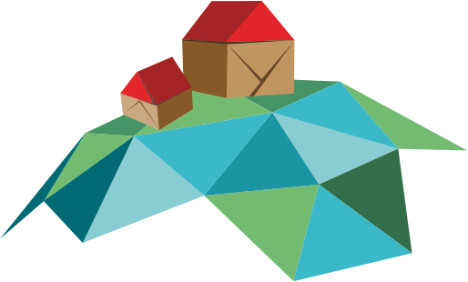
Drivers of wetland loss and degradation
Sustainable use of wetlands requires an understanding of the drivers of wetland loss and degradation so that the root causes can be addressed.
Draining and infilling
Over Extraction 0f Water
Pollution
Overfishing
Climate Change
Sources:
Global Wetlands Outlook 2018

Slide 5
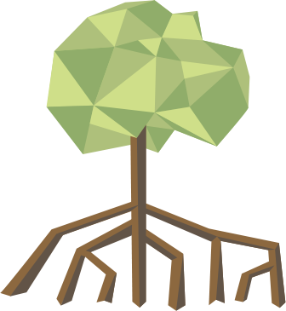
Wetlands are biodiverse and essential ecosystems
Wetlands currently cover roughly 6% of the Earth’s land surface.
They can be saltwater or freshwater, inland or coastal, natural or human-made.
Freshwater wetlands include: rivers, lakes, pools, flood plains, peatlands, marshes, swamps
Saltwater wetlands include: estuaries, mudflats, saltwater marshes, mangroves, lagoons, coral reefs, shellfish reefs
Human-made wetlands include: fishponds, rice paddies, reservoirs, saltpans

Slide 6
Wetlands loss affects people and the planet
Human well-being
Water security
Wetlands provide almost all our fresh water.
The Earth’s kidneys, wetlands’ silt-rich soil and plants filter against harmful toxins, agricultural pesticides and industrial waste — leaving safe water to drink.
The UN Water Report (2018) mentions wetlands as nature-based solutions that can help improve water quality.
There are already 2.2 billion people without safe drinking water, and 485,000 die each year.
Water insecurity is a major role in conflict in at least 45 countries in 2017.
Well-being and culture
Wetlands provide recreation spaces, cultural engagement and mental health benefits tied to interacting with nature.
Sources:
factsheet_wetland_restoration_general_e_0.pdf (ramsar.org)
Slide 1 (ramsar.org)
factsheet_wetland_restoration_peatlands_e.pdf (ramsar.org)

Slide 7
Wetlands loss affects people and the planet
Climate regulation and human safety
Wetlands are natural shields and help us cope with climate change and its impacts.
Wetlands safeguard the 60% of humanity along coastlines against storm surges, hurricanes and tsunamis.
Each acre of inland wetlands absorbs up to 1.5 million gallons of floodwater, helping to reduce floods and delay and relieve droughts.
Coastal wetlands sequester and store carbon up to 55X faster than tropical rain forests.
Peatlands store ~30% of land-based carbon — 2X the amount of all the world’s forests.
Drained peatlands and peatland fires are responsible for an estimated 4% of global anthropogenic greenhouse gas emissions.
Biodiversity
40% of the world’s plant and animal species live or breed in wetlands
Rich nutrients — carried by rivers, streams and water power the food chain.
>100,000 freshwater species identified in wetlands.
Home to 30% of known fish species, with 200 new freshwater species discovered each year
Sources:
WWD19_2Handout_english.indd (ramsar.org)
wwd16_hand-outs_desktop_print_eng.pdf (ramsar.org)
Ramsar-50-Factsheet-BIODIVERSITY-English.pdf (ramsar50.org)
Summary of the Thirteenth Meeting of the Conference of the Parties to the Ramsar Convention on Wetlands | Ramsar

Slide 8
Take 3 actions to reverse wetlands loss
Three Response Actions
MANAGE them wisely and use sustainably to conserve and maintain their health
VALUE their multiple benefits and nature-based solutions
RESTORE to revive biodiversity and life

Slide 9
Value wetlands
1
Throughout history wetlands have been viewed as wastelands.
We can value wetlands by:
Recognizing the multiple benefits and nature-based solutions they provide
All of society understands the full range of economic, social-cultural and environmental benefits, goods and services wetlands offer.
Capturing the importance of wetlands through economic valuation:
Capturing the monetary benefits and economic value helps convince decision-makers faced with trade-offs. It generates information about the goods and services that wetlands offer — providing a basis for policy formation and analysis.
Ensuring that policies and decision-making reflect the full value of wetlands:
Incorporate wetland conservation and wise use into national policy plans and actions — including the designation of Wetlands of International Importance, wetland inventories, and laws and policies that regulate activities in wetlands.
Sources:
TEEB Approach – Barbier, Acrerman and Knowler, in Economic Valuation of Wetlands: A Guide for Policy Makers and Planner

Slide 10
Manage wetlands
2
Managing wetlands wisely and using them sustainably conserves and maintains their health.
The Convention defines wise use as “the maintenance of the ecological character of wetlands, achieved through the implementation of ecosystem approaches, within the context of sustainable development.”
Actions that will promote the wise use of wetlands include:
Adopt national wetland plans, policies and legislation — separately or as a part of wider initiatives
Create programs covering wetland inventory, monitoring, research, training, education and public awareness
Develop integrated management and wise use plans at wetland sites
Include area stakeholders in discussions from the start
Undertake wetlands inventory and impact assessments
Name or create an authority to implement the plan
Monitor the site for changes
Apply for Ramsar Site designation
Ecological character is the characteristics of a wetland at a given time — the combination of its components, processes, benefits and services.
Sources:
factsheet2_wise_use_basics_0.pdf (ramsar.org)
The Wise Use of wetlands | Ramsar

Slide 11
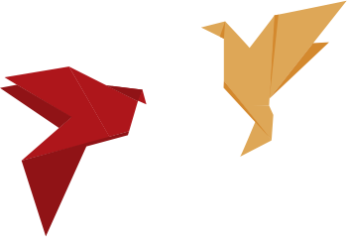
Restore lost and degraded wetlands
3
Essential elements for restoring wetlands
Manage water
Understand waterflow patterns and conduct hydrological restoration
Construct flood mitigation systems
Build storm water treatment areas
Rewet peatlands
Reestablish suitable vegetation
Reforest mangroves and other vegetation
Create community nurseries to produce seedlings
Manage pollution
Close or dismantle illegal structures
Manage solid waste
Conduct cleanups
Involve the local community
Draw knowledge from indigenous communities
Create community monitoring systems to ensure the protection and conservation of the wetlands
Establish public-private partnership programs
The UN Decade on Ecosystem Restoration 2021-2030 offers the opportunity to join efforts to reverse the degradation of our planet’s wetlands — nearly 90% have been degraded since the 1700s.
Sources:
factsheet_wetland_restoration_general_e_0.pdf (ramsar.org)
factsheet_wetland_restoration_peatlands_e.pdf (ramsar.org)
factsheet_wetland_restoration_coastal_e.pdf (ramsar.org)

Slide 12
“The wise and sustainable use of wetlands is not only possible ― it’s critical to the future of humanity and the planet. Continued harm to these life-sustaining ecosystems will have dire consequences if we don’t act now. In many ways, wetlands are our lifeline to the future. And we must make the necessary investments of time, capital — and heart — to save them.”
Martha Rojas Urrego
Secretary General of the Convention on Wetlands

