Slide 1
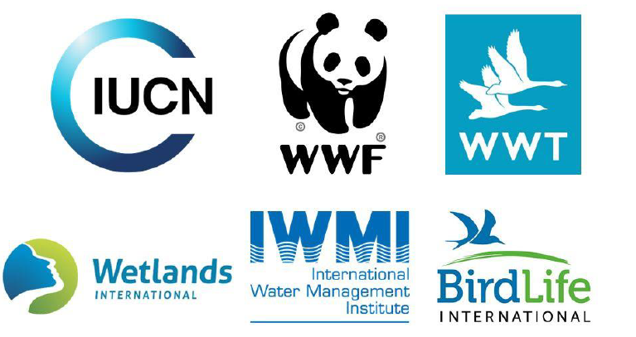
Seven Priorities for Wetland Restoration
1. Commit to new global targets for wetland restoration in kilometers and hectares
Embed the new global targets of at least 350 million hectares of wetlands and 300,000 km of rivers under restoration by 2030 into national site action and integrate actions into broader water management.
Support the Freshwater Restoration Challenge designed to mobilize action and resources to achieve these targets. The Challenge will be launched at the UN Water Conference (March 2023).
2. Incorporate wetland restoration into NBSAPs
Adopt the two restoration targets of at least 350 million hectares of wetlands and 300,000 km of rivers under restoration by 2030 into national biodiversity strategic action plans (NBSAPs).
At the same time, incorporate the restoration targets into national climate actions and plans (NAPAs, NDCs) to ensure wetland, biodiversity and climate benefits are integrated and aligned to maximise the impact of restoration.
3. Improve monitoring and wetland inventories
Update and continuously improve wetland inventories and improve biodiversity monitoring at wetland sites to ensure contribution to species recovery.
4. Fully Utilize the Montreux Protocol
Seek support from Ramsar Advisory Missions and IOPs
Prioritize sites for restoration and protection leading to removal from the list

Slide 2
Seven Priorities for Wetland Restoration
5. Adopt a landscape approach to restoration
Wetlands are part of a broader hydrological, chemical, biodiverse and social system. Restoration activities should adopt a landscape approach to mobilise appropriate science and knowledge for site management and restoration activities.
Landscape approaches help to mobilise diverse sectors and interests to improve understanding and sustainability, ensures greater inclusion and active engagement, and helps to foster local and indigenous community involvement.
6. Incorporate restoration activities in productive landscapes
Incorporate productive landscapes into restoration activities. Under Target 10 of the Global Biodiversity Framework areas including floodplains, forests, and economic activities in these areas such as agriculture and fisheries can all contribute to wetland restoration activities through improved management and planning, and reductions in chemical use and other pollutants.
7. Strengthen the governance of wetlands to ensure long term protection and success
Address the indirect and direct drivers of nature loss through the creation of clear governance mechanisms to mobilise restoration and to maintain long term action and protect sites to meet the 2030 targets and beyond.

