Slide 1
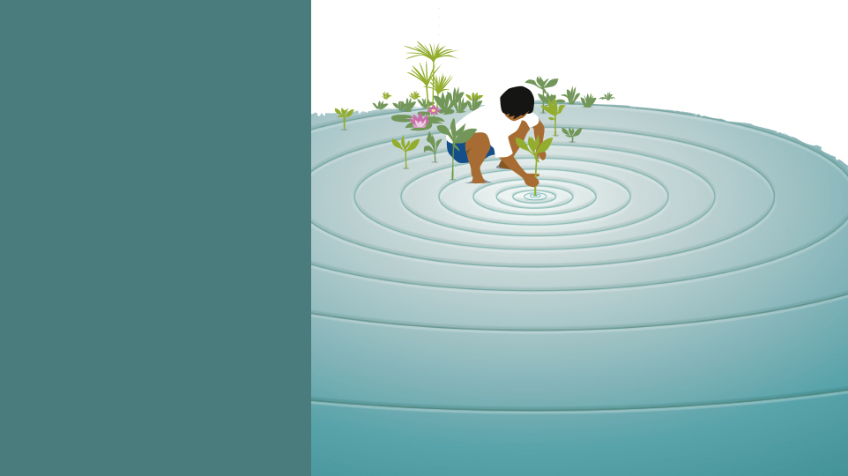
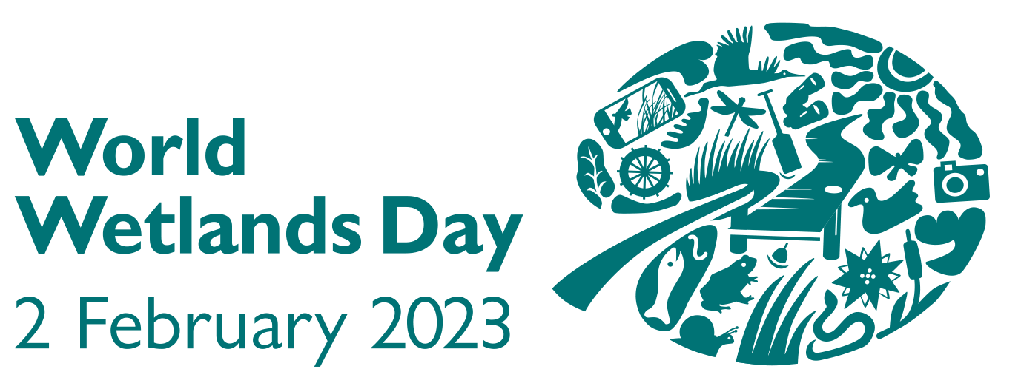
Date:
It’s time
for wetland restoration
Name:
www.worldwetlandsday.org #GenerationRestoration #ForWetlands

Slide 2
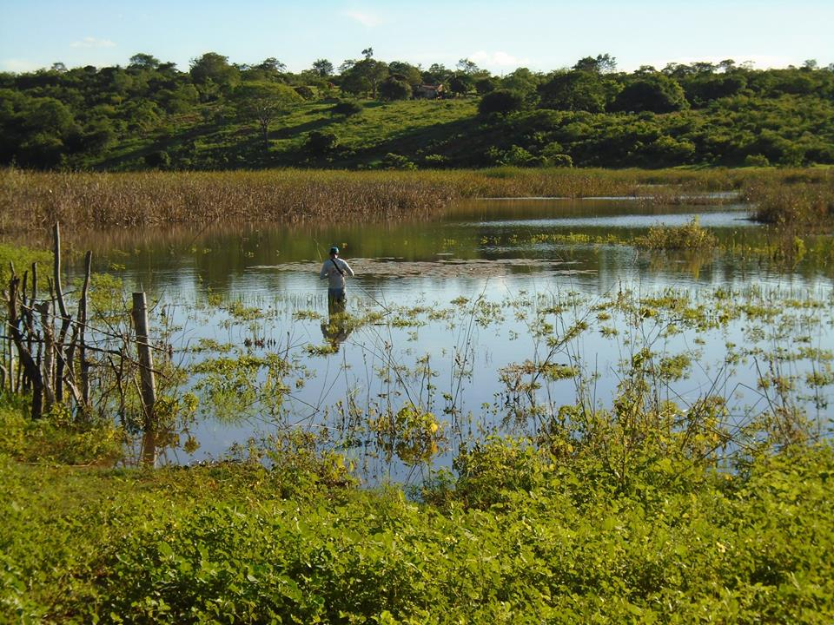
Wetlands
Land areas that are saturated or flooded with water either permanently or seasonally.
TYPES OF WETLANDS
Inland wetlands:
marshes, lakes, rivers, floodplains, and swamps
Coastal wetlands:
saltwater marshes, estuaries, mangroves, lagoons and coral reefs
Human-made wetlands:
Fish ponds, rice paddies and salt pans

Slide 3
Wetland restoration: Why is it time?
Wetlands are being lost three times faster than forests.
Earth’s most threatened ecosystem.
More than 80% of all wetlands have disappeared since the 1700s.
Trend is accelerating. Since 1970, at least 35% of wetlands have been lost.
Human activities are driving degradation.
Wetlands are being drained and filled in for crops, grazing and construction.
Water pollution and overfishing are harming wetland ecosystems, along with invasive species.
Wetland species are facing extinction.
One in three freshwater species and 25% of all wetland species face extinction from wetland decline.
81% of inland wetland species and 36% of coastal and marine species have declined in the last 50 years.

Slide 4
Wetlands are vital for humanity…
Freshwater is rare. Wetlands provide most of it.
2.5% of water on earth is freshwater, mostly stored in glaciers and aquifers.
Less than 1% is usable, and over 30% of that is found in wetlands such as rivers and lakes.
Wetlands store more carbon than forests.
Peatlands cover 3% of our planet yet store around 30% of all land-based carbon.
Coastal wetlands like mangroves sequester and store carbon up to 55 times faster than tropical rain forests.
Wetlands help us cope with storms and flooding.
60% of humanity lives and works in coastal areas. Saltmarshes, mangroves, seagrass beds and coral reefs shield coastal communities.
Inland, a single acre of wetland can absorb up to 1.5 million gallons of floodwater.
Wetlands give livelihoods to one billion and feed 3.5 billion.
More than a billion people live from fishing, aquaculture and tourism.
Wetland paddies provide rice for 3.5 billion people.

Slide 5
Wetland restoration is urgent. What are the best ways to approach it?

Slide 6
Follow seven best practices
Restore multiple benefits
Natural wetlands provide many services, from flood control to livelihoods.
Aim to recapture multiple benefits; don’t concentrate on just one or two.
Create a self-sustaining wetland
Wetland vegetation, wildlife and the site itself all draw from and give to each other.
Aim to re-create this complex, self-sustaining cycle.
Involve the community
Ensure that local residents and businesses have a voice in planning and implementing the restoration.
Give them a role in maintaining the restored site.

Slide 7
Follow seven best practices
Limit the causes of degradation
Remove or limit pressures that affect the area, such as overharvesting of water or pollution.
Clean up the degraded area
Remove any debris, trash and waste that has accumulated in the wetland.
Restore native flora and fauna
Re-create the original hydrological conditions
Replant native vegetation, reintroduce wildlife, weed out invasive species.
Structure access to the wetland
Create specific spaces for people to access the wetland. List which activities are allowed where. Designate zones where wildlife can thrive undisturbed.

Slide 8
Why is restoring wetlands worthwhile?

Slide 9
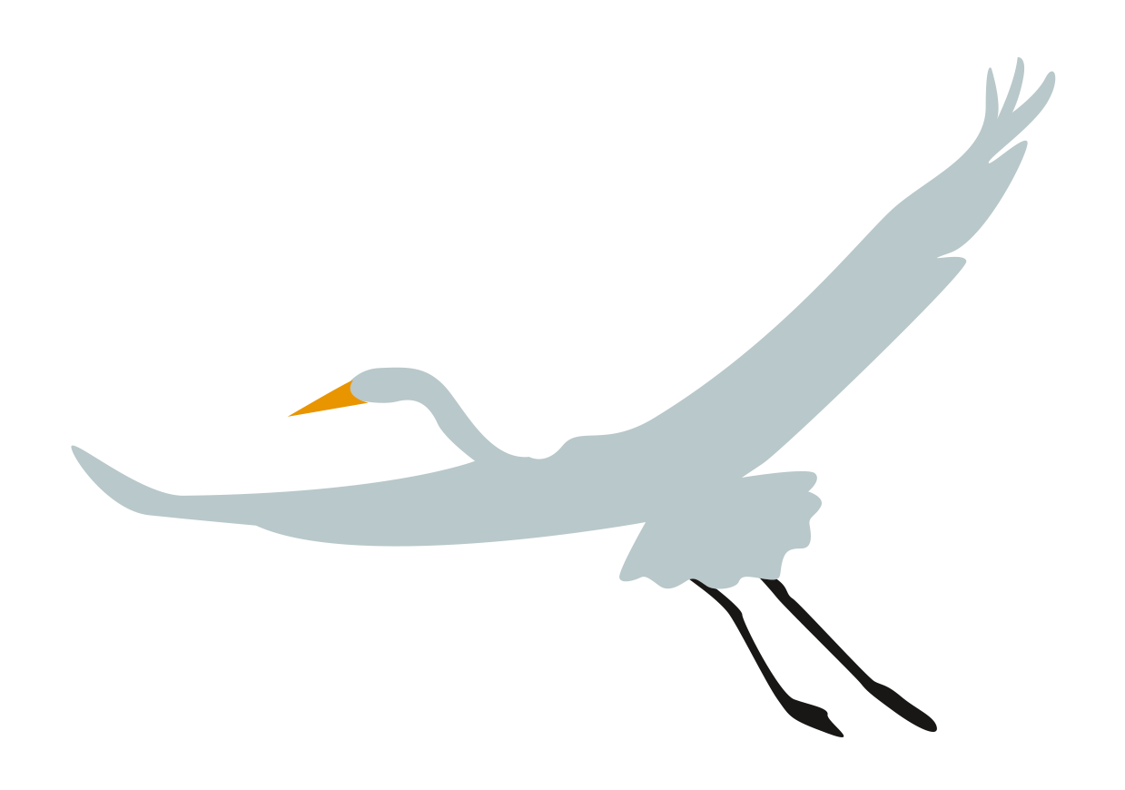
Restored wetlands bring 7 key benefits
Revive biodiversity
40% of the world’s species live or breed in wetlands. Restoring wetlands powers the local food chain and attracts wildlife.
Replenish and filter water supply
Wetlands naturally filter water, remove pollutants and boost the local water supply.
Store carbon
Specific types of wetlands, especially peatlands, mangroves, intertidal marshes and seagrass beds are exceptionally efficient carbon sinks.
Blunt the impact of floods and storms
Restored wetlands can act as sponges against excess rainfall and flooding, buffer coastal storm surges, and can shield communities in extreme weather.

Slide 10
Restored wetlands bring 7 key benefits
Improve livelihoods
Wetlands create livelihoods in fishing and aquaculture, and also provide goods like reeds and grasses. These opportunities often benefit indigenous populations.
Boost eco-tourism
A restored wetland can be a sustainable magnet for visitors; a natural attraction that draws tourists along with opportunities to serve them.
Enhance quality of life
Revitalized wetlands provide a place to relax, experience nature – and a enjoy sense of satisfaction at their resurgence.

Slide 11
Wetland restoration is a major undertaking. Who makes it happen?

Slide 12
7 key players work together
#GenerationRestoration:
Enthusiastic individuals like you support restoration with your own choices, voices and actions, and by getting involved in local initiatives.
Public sector:
Local, regional and national governments typically enable, encourage and facilitate a wetland restoration initiative. They gather input from key stakeholders, make trade-off decisions, and often lead and manage the project.
Funders:
Governments, financial institutions, foundations and individuals provide the actual funding needed to make the restoration project a reality.

Slide 13
7key players work together
Community leaders:
Understand which benefits are most important to residents, and ensure that locals have a voice.
Private sector:
Local fishers and farmers often depend on wetlands, so restoration can enhance their livelihoods. The agricultural, beverage and food industries are also beneficiaries.
Educators:
Teachers and other educators work to raise awareness of the advantages of wetland restoration.
Scientists and wetland practitioners
Technical experts provide in-depth knowledge to the community and the project leaders, and ensure technology and innovation play a role in wetland restoration.

Slide 14
How can I personally get involved or contribute?

Slide 15
Conscious choices
Make personal choices that minimize the loss and degradation of wetlands
Learn more about wetlands
Become aware of the major threats to this valuable ecosystem such as drainage, pollution from waste and chemicals, and invasive species.
Make water-friendly and ecosystem conscious decisions.
Use water sparingly. Adopt a diet with less environmental impact. Avoid using toxic products that could flow into wetlands. Don’t dump waste or rubbish in wetlands.
Make your own Pledge to Act for Wetland Restoration.
The “Wall of Pledges” is a great place to post your Conscious Choices, Persuasive Voices and Bold Actions for Wetland Restoration.

Slide 16
Persuasive voices
Become a wetland champion
Advocate for protecting local wetlands, and for restoring degraded ones.
Use your social media outreach to maximize awareness of wetlands
Highlight World Wetlands Day on Twitter, Instagram, Facebook and other social media platforms. Use the hashtags #GenerationRestoration #ForWetlands or #WorldWetlandsDay.
Take a wetlands field trip to see where restoration is needed.
Once on site, consider what the wetland does for the area, and whether it is degraded.
Host a talk to support wetland restoration
An educational event can help build support for a restoring a local wetland. Call on wetland experts, local people who make their livings in wetlands to underline why restoration is important.

Slide 17
Bold actions
Use your own power to create change and support wetland restoration, locally, regionally or nationally:
Create an advocacy effort
Encourage local, state and national governments to protect local wetlands and restore degraded ones.
Hold or join a public wetlands cleanup day
Remove debris, trash and waste that has accumulated in the wetland.
Get directly involved in a local wetland restoration project.
Get input and help ensure that the restoration efforts reflect the needs of local residents.
Add your event to the global map and search directory.
Our online interactive map shows what events are taking place and where around the world for World Wetlands Day.
Share a photo of your bold actions on the Restoration Photo Gallery.
This photo gallery aims to show where restoration is happening around the world to motivate and inspire more restoration efforts.

Slide 18
Wetland restoration is in your hands! Thank you!

